Slide 1

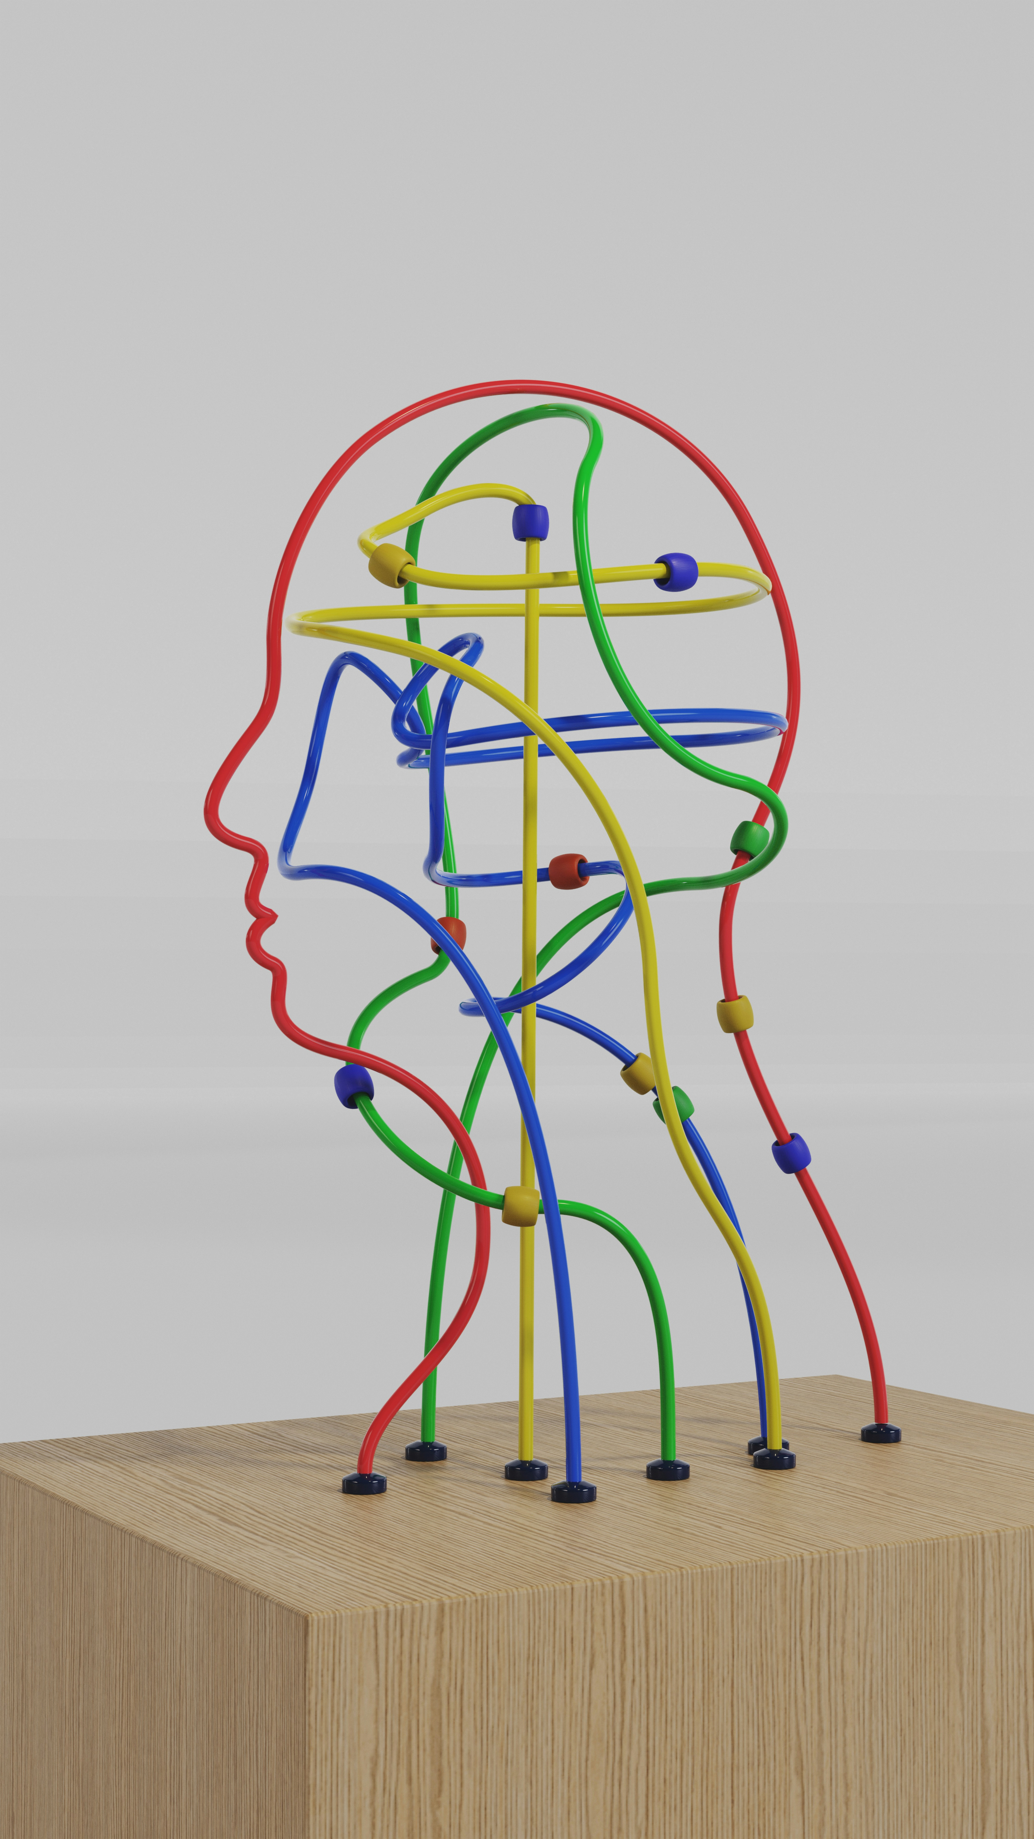
PSY7142 Understanding Humans Through Data

Slide 2
Module outline
Week 1: Introducing data, introducing Rstudio
Week 2: Manipulating data, using Rstudio
Week 3: Exploring data and creating figures and graphs, using Rstudio
Week 4: Categorical data and the chi-squared test – testing random versus structured?
Week 5: t-tests – testing whether two groups are different
Week 6: Research report/analysis
Week 7: Measurement, hypotheses, associations (correlations)
Week 8: Predicting behaviour: the linear model
Week 9: Data visualisation
Week 10: Predicting behaviour: developing the linear model

Slide 3
Objectives for Week 3
By the end of this session, you should be able to:
See how data gathering for vocabulary knowledge can be conducted
Understand different types of reproducibility
Understand the relations between observed score, true score, and error score
Understand multiple types of graphs and how to construct them in Rstudio
Manipulate data, including filtering, grouping and summarizing data in Rstudio

Slide 4
Rstudio and R: inputting data I
We will further practise inputting, investigating, and manipulating data
We will begin to look at a data set that we first looked at last week
How many words do you know?
What factors predict how many words you know?

Slide 5
Rstudio and R: inputting data II
The data is called “PSYC411-shipley-scores-anonymous-17_18.csv”, it is available on the moodle site in the week 3 folder
The data contains information similar to that you entered into the moodle questionnaire:
  Subject ID: anonymised subject number
  english_status: whether the participant is native or English as a second language (ESL)
  Gender
  Shipley_Voc_Score – score on the Shipley vocabulary test
  Gent_1/2 Score – score on the Gent vocabulary test 1st and 2nd go
  Academic_year: 201718 or 201819
    (Age, and Dyslexia_diagnosis: we’re not using these)

Slide 6
Types of data?
Which of these are nominal which are interval/ratio?
  english_status: whether the participant is native or English as a second language (ESL)
  Age
  Gender
  Shipley_Voc_Score – score on the Shipley vocabulary test
  Gent_1/2 Score – score on the Gent vocabulary test 1st and 2nd go
  Academic_year: 201718 or 201819

Slide 7
Relations among the data?
Which of these are likely to relate to vocabulary scores?
  english_status: whether the participant is native or English as a second language (ESL)
  Age
  Gender
  Academic_year: 201718 or 201819

Slide 8
Rstudio and R: representing data
Open the file: dat <- read_csv("PSYC411-shipley-scores-anonymous-17_18.csv")
Now look at the data: View(dat)
We can make a histogram of the first time people took the Gent vocabulary test:
  hist(dat$Gent_1_score)
And a histogram of the second time people took the Gent test:
  hist(dat$Gent_2_score)
We can find out means and standard deviations
  mean(dat$Gent_1_score) and sd(dat$Gent_2_score)
Also using summarise function:
  summarise(dat,mean(Gent_1_score),sd(Gent_1_score), n())
  summarise(dat,mean(Gent_1_score, na.rm=T),sd(Gent_1_score, na.rm=T), n())

